Slide 1

Proportional Control
By Sanjay and Arvind Seshan

Slide 2
Lesson Objectives
Learn what proportional control means and why to use it
Learn to apply proportional control to different sensors
Prerequisites: Math Blocks, Color Sensor Calibration, Data Wires

Slide 3

Learn and Discuss Proportional Control
Let’s start with a game
Imagine that you blindfold one teammate. He or She has to get across the room as quickly as they can and stop exactly on a line drawn on the ground
The rest of the team has to give the commands.
When your teammate is far away, the blindfolded person must move fast and take big steps. But as he gets closer to the line, if he keeps running, he will overshoot. So, you have to tell the blindfolded teammate to go slower and take smaller steps.
You have to program the robot in the same way!

Slide 4
What Proportional Control Looks Like
The Pseudocode for every proportional control program consists of two stages:
Computing an error → how far is the robot from a target
Making a correction → make the robot take an action that is proportional to the error (this is why it is called proportional control). You must multiply the error by a scaling factor to determine the correction.
Compute Error
Make Correction

Slide 5
Challenge
To learn how to use proportional control, create a Robot Follower program
Use proportional control with the ultrasonic sensor to get the robot to stay 15cm away from the human at all times (even when the human moves)
Objective | Error | Correction
Get to a target distance from human | How many cm from target location (current_distance – target_distance) | Move faster based on distance

Slide 6
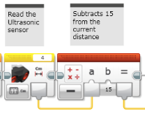
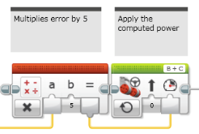
Challenge
Compute Error
How many cm from target location (current_distance – target_distance)
Compute/Apply Correction
Move faster based on distance
error
error

Slide 7
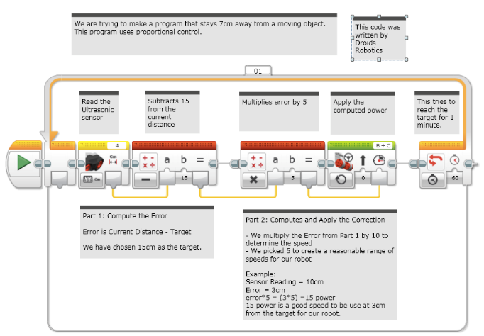
Putting It All Together: Ultrasonic Robot Follower

Slide 8
How Far Is the Robot From The Line?
Reflected light sensor readings show how “dark” the measured area is on average
Calibrated readings should range from 100 (on just white) to 0 (on just black)
Light Sensor Measured Area:
Reading = 100
Reading = 50
Reading = 25
Reading = 75
Reading = 0
Line

Slide 9
Line Following
Computing an error → how far is the robot from a target
Robots follow the edge of line → target should be a sensor reading of 50
Error should indicate how far the sensor’s value is from a reading of 50
Making a correction → make the robot take an action that is proportional to the error. You must multiply the error by a scaling factor to determine the correction.
To follow a line a robot must turn towards the edge of the line
The robot must turn more sharply if it is far from a line
How do you do this: You must adjust steering input on move block

Slide 10
How do you make a Proportional Line Follower?
Pseudocode:
Reset the Rotation sensor (Only required for line following for a total distance)
Compute the error = Distance from line = (Light sensor reading - Target Reading)
Scale the error to determine a correction amount. Adjust your scaling factor to make you robot follow the line more smoothly.
Use the Correction value (computed in Step 3) to adjust the robot’s turn towards the line.

Slide 11
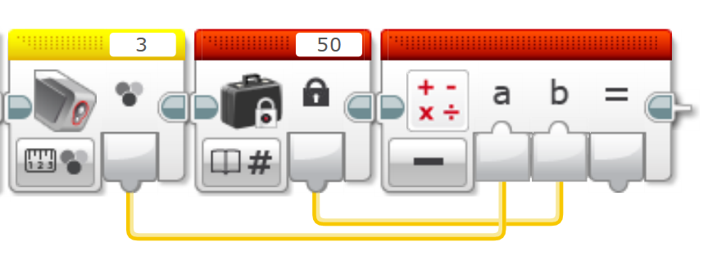
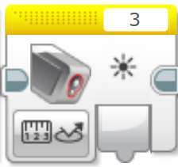
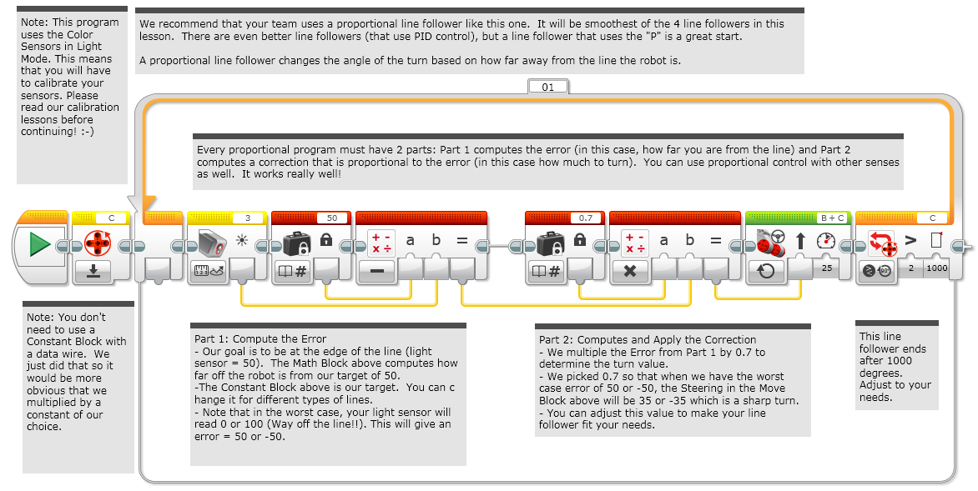
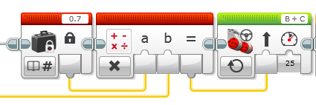
Challenge
Compute Error
Distance from line = (Light sensor reading - Target Reading)
Compute/Apply Correction
Scale the error to determine a correction amount. Use this to adjust steering input on move block
error
error

Slide 12
A Proportional Line Follower

Slide 13
Key Step: Tuning the Constant
Note, the 0.7 constant in the previous slide is specific to our robot – you need to tune this value for yourself
This constant is called the Proportional Constant, or Constant of Proportionality
The most common way to tune your constant is trial and error.
This can take time. Here are some tips:
Start with your constant as1.0 adjust by ±0.5 initially
Adjust to a point where the controller is pretty smooth
Adjust ±0.1 for fine tuning

Slide 14
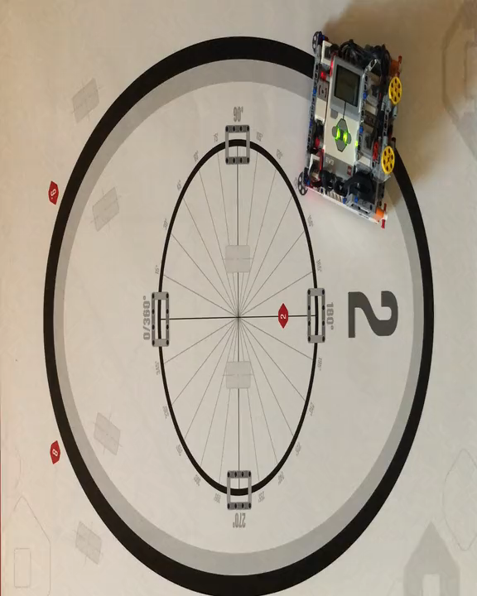
Proportional Control (0.6 Constant)
Play video. Turn on volume

Slide 15
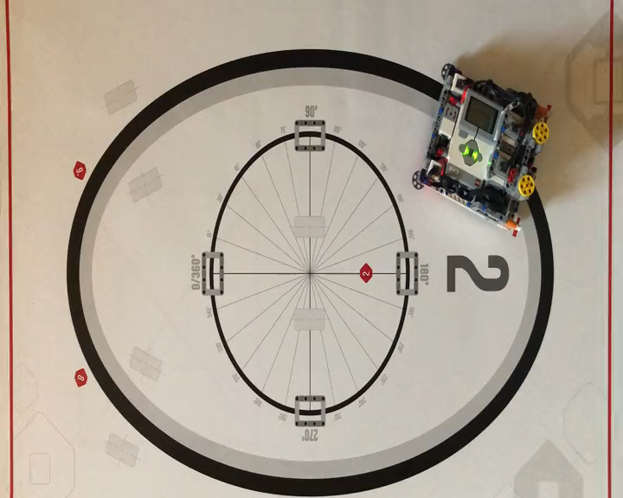
Proportional Control (0.8 Constant)
Play video. Turn on volume

Slide 16
Discussion Guide
What does proportional control mean? Ans. Moving more or less based on how far the robot is from the target distance
What do all proportional control code have in common? Ans. Computing an error and making a correction

Slide 17
Credits
This tutorial was created by Sanjay Seshan and Arvind Seshan
More lessons at www.ev3lessons.com
This work is licensed under a Creative Commons Attribution-NonCommercial-ShareAlike 4.0 International License.

